Slide 1


E- COMMERCE
Guided By​
Mrs. Pooja Mehta​
Presented By​
Gayathri . M
Harini . V​
Preethikadevi . V
Rohini . K
Surya . B​
Sathesh . A​
Subarna Jyothy . R​

Slide 2
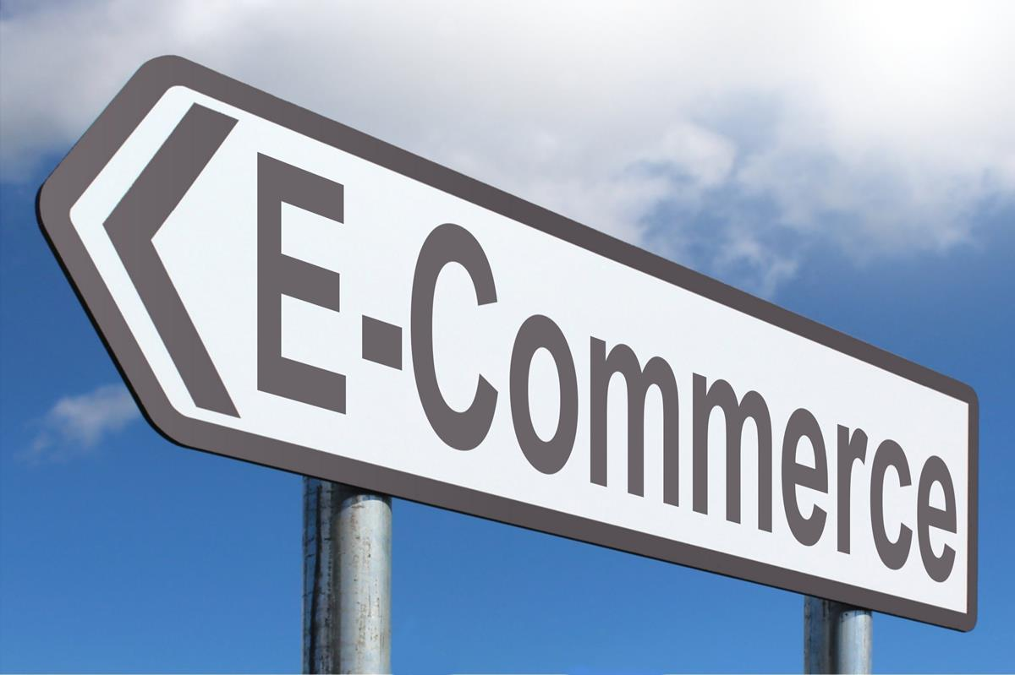
ABSTRACT
It is commonly known as electronic marketing
Electronic commerce (e-commerce) refers to companies and individuals that buy and sell goods.
Ecommerce is the buying and selling of goods and services over the Internet.
It is conducted over computers, tablets, smartphones, and other smart devices.
Almost anything can be purchased through ecommerce today, for this reason, ecommerce is often highly competitive.

Slide 3
SYSTEM REQUIREMENTS
Hardware Configuration​ | Software Configuration​
Operating System : Windows 10​ | Software IDE : Spring Boot​
Hard Disk :1 TB​ | Language : Java , HTML, CSS, Bootstrap
RAM : 8GB​ | Back End : MySQL Server , Postman​ Front End : Angular

Slide 4


TECHNOLOGIES USED
Spring boot
Postman
MySQL
Angular

Slide 5
SYSTEM ANALYSIS
EXISTING SYSTEM:
The Customer is completely depending on the manual process for buying the products.
The time which has been spent by the customer in manual shopping can equates to multiple number of shopping

Slide 6
DISADVANTAGES:
Unable to Examine products personally​
Not everyone is connected to the Internet.​

Slide 7
PROPOSED SYSTEM
Propose system aims at implementing the recommendation system for customers to get the items they want.
That can give out effective recommendations for users which are satisfying to them to a great extent.
Customers can get many benefits and also the trading volume can be increased.

Slide 8
ADVANTAGES
Fater buying or selling procedure as well as easy to find products
Buying or Selling is 24/7 available.
Low operational costs and better quality of services
Customers can easily select products from different providers without moving around physically.

Slide 9
GOALS
The main goals of our project are:
User friendly navigation to provide ease.
Help user by providing specification of products
Full Security System.

Slide 10
TEMPLATES
Signup and Login Page
Home Page
Shop and Cart Page
User Account Information

Slide 11
SOFTWARE OVERVIEW
JAVA: It is a simple programming language. Java makes writing, compiling, and debugging programming easy. It helps to create reusable code and modular programs.
MySQL: MySQL is a relational database management system (RDBMS) developed by Oracle that is based on structured query language. A database is a structured collection of data.

Slide 12

BOOTSTRAP:
Bootstrap is a free front-end framework for faster and easier web development. Bootstrap includes HTML and CSS based design templates for typography, forms, button, tables, navigation, models, image and many other, as well as optional JavaScript plugins
POSTMAN:
Postman is an Application Programming Interface (API) testing tool. API acts like an interface between a couple of applications and establishes a connection between them.

Slide 13
ANGULAR :
Angular is a development platform, built on TypeScript. As a platform, Angular includes:
A component-based framework for building scalable web applications
A collection of well-integrated libraries that cover a wide variety of features, including routing, forms management, client-server communication, and more
A suite of developer tools to help you develop, build, test, and update your code.
HIBERNATE:
Hibernate is a framework in Java which comes with an abstraction layer and handles the implementations internally.
The implementations include tasks like writing a query for CRUD operations or establishing a connection with the databases.

Slide 14
Spring Validation
Spring features a Validator interface that you can use to validate objects. The Validator interface works using an Errors object so that while validating, validators can report validation failures to the Errors object.

Slide 15
SPRING ANNOTATIONS
@Controller: The @Controller annotation indicates that a particular class serves the role of a controller. Spring Controller annotation is typically used in combination with annotated handler methods based on the @RequestMapping annotation.
@Autowired: The @Autowired annotation provides more fine-grained control over where and how autowiring should be accomplished.
@RequestMapping: @RequestMapping is one of the most common annotation used in Spring Web applications. This annotation maps HTTP requests to handler methods of MVC and REST controllers.
@Entity: The @Entity annotation specifies that the class is an entity and is mapped to a database table.

Slide 16
@Table: The @Table annotation is used to create a table in database.
@JoinColumn: @JoinColumn is used to specify a column for joining an entity association or element collection.
@PutMapping: @PutMapping is used for update the records.
@PostMapping: @PostMapping is used to create a resource.
@GetMapping: @GetMapping is used to read all the inserted records.
@DeleteMapping: @DeleteMapping is used to delete the records.
@Param: @Param is used to denote a description of the parameter a method can receive.
@Path Variable: The @Path Variable annotation is used to extract the value from the URL.

Slide 17
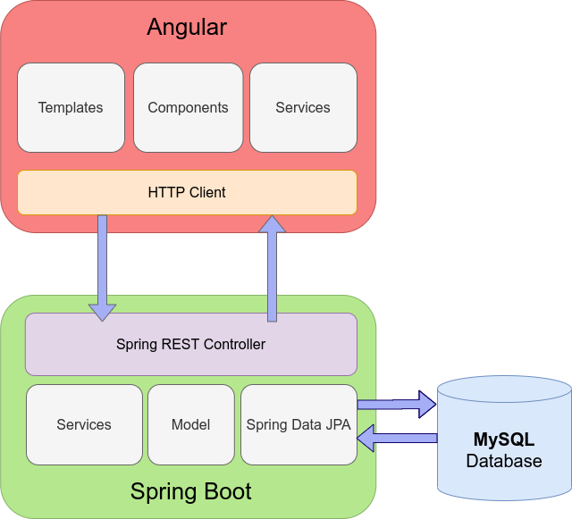
ARCHITECTURE

Slide 18
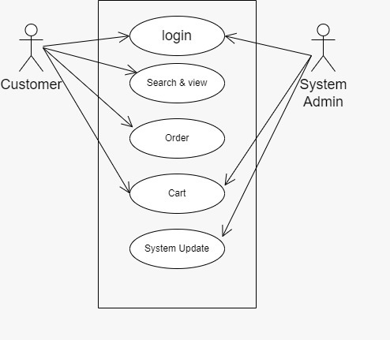
USECASE DIAGRAM

Slide 19
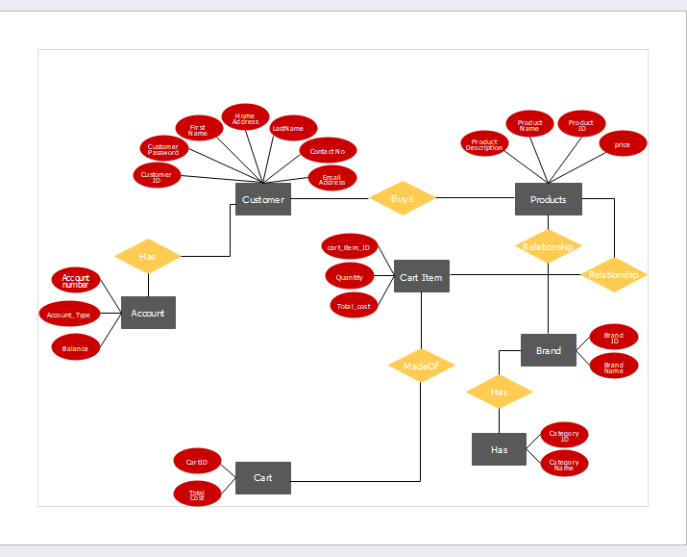
ER DIAGRAM

Slide 20
MODULES
Admin :
Admin has the official powers to control the flow of the data from one part of the system to the other.
He can manipulate the access of the users to the data.
Hence all the data will be reflected in clean and well data in the interfaces.
Customer :
Check the all products and give order of products. Check order status and see recently add cart products.

Slide 21
Order:
The order from the dealer is taken through phone and the products; quality is entered by an employee.
After that it resolve be saved in the database and a crystal account will have produced for billing purpose.
Cart :
After trade, the products will be directed to the cart. In the cart unit we can get the total quantity of products available.
Payment :
Configurable to permit and charge, or authorize only and on conception of invoices. Cash on delivery available.
Product :
Detail information about product which is provided by admin.

Slide 22
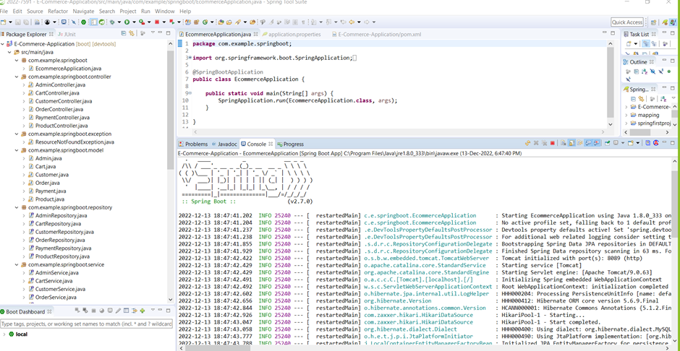
OUTPUT SCREENSHOT
STS:

Slide 23
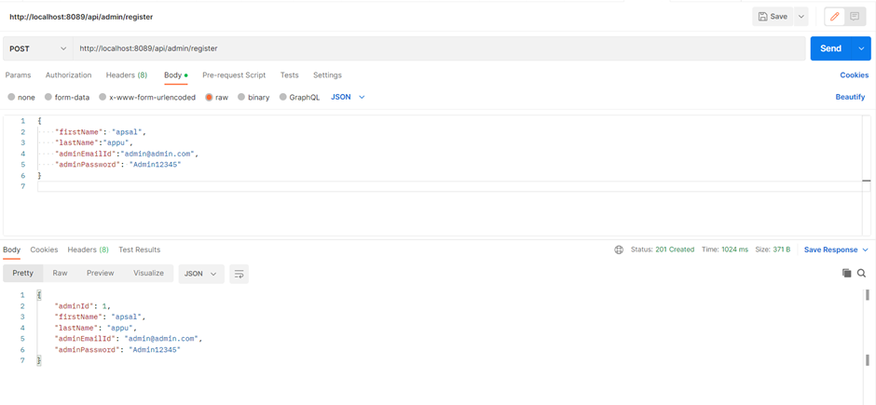
POSTMAN:

Slide 24
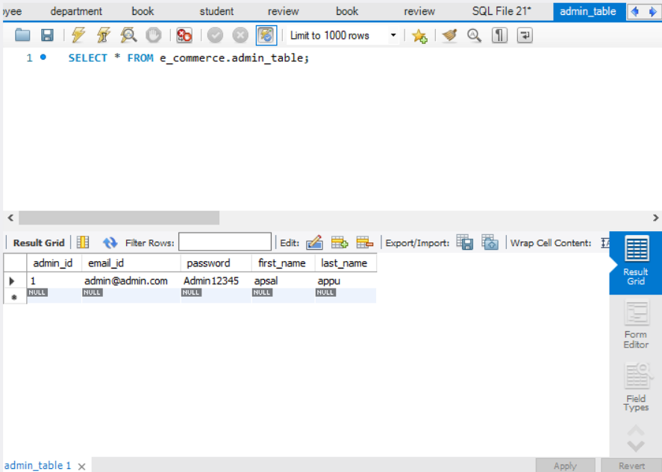
ADMIN TABLE

Slide 25
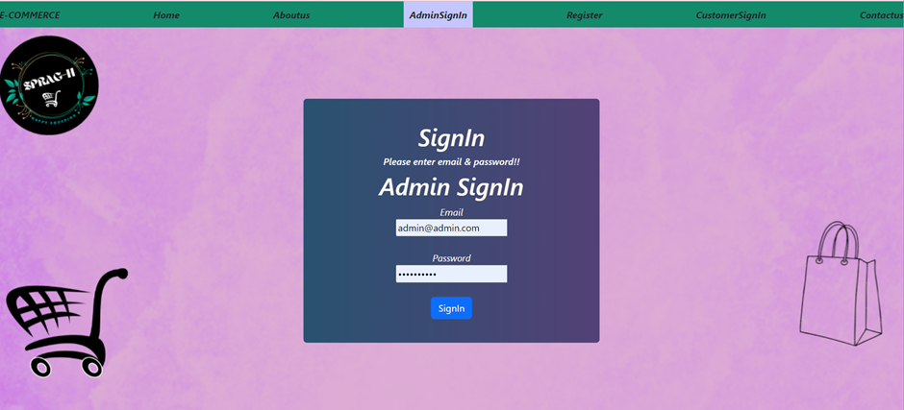
ADMIN SIGNIN

Slide 26
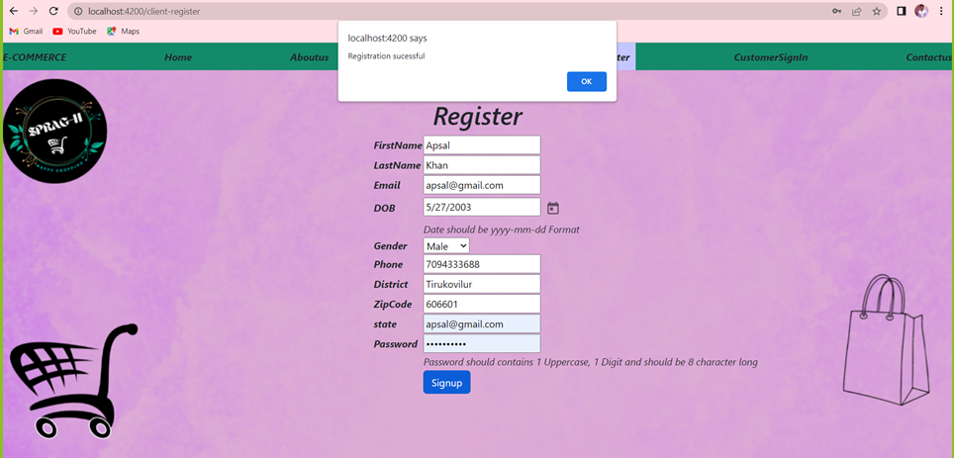
REGISTER:

Slide 27
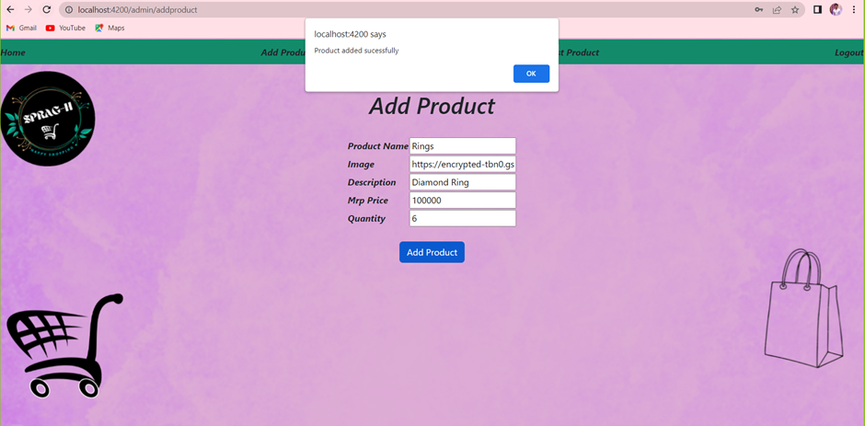
ADD PRODUCT

Slide 28
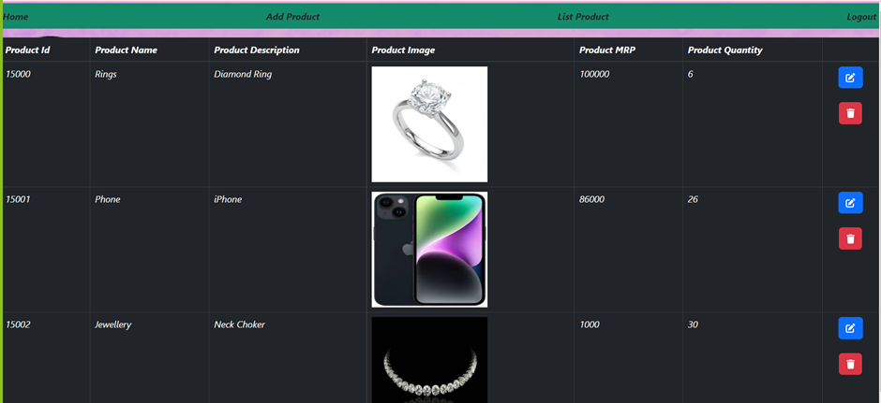
PRODUCT LIST

Slide 29
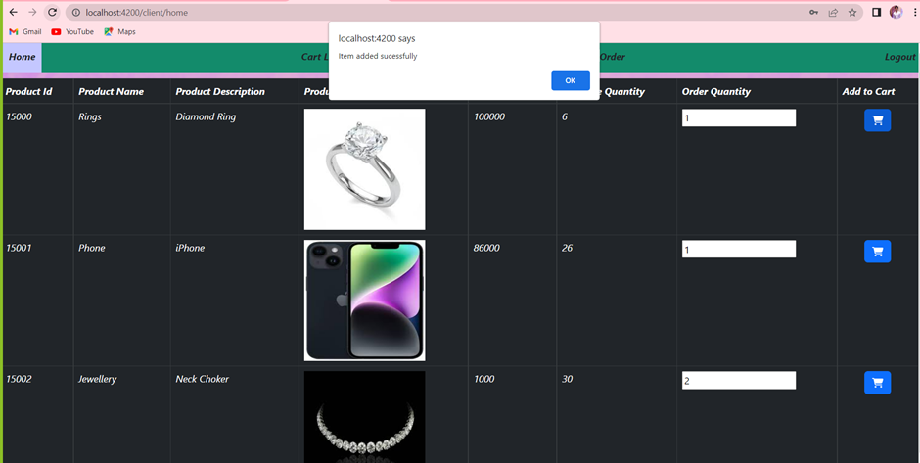

Slide 30
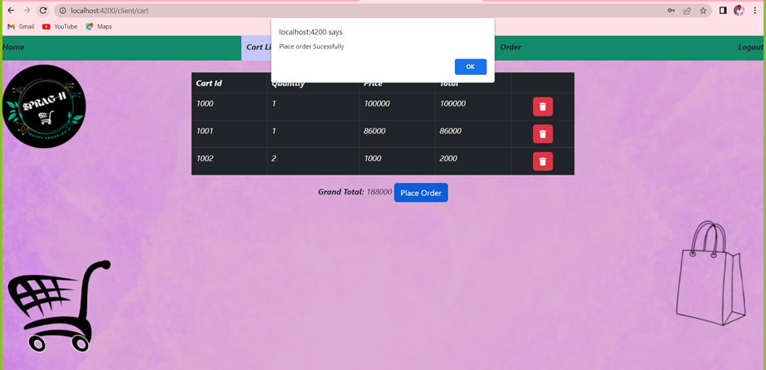
CART

Slide 31
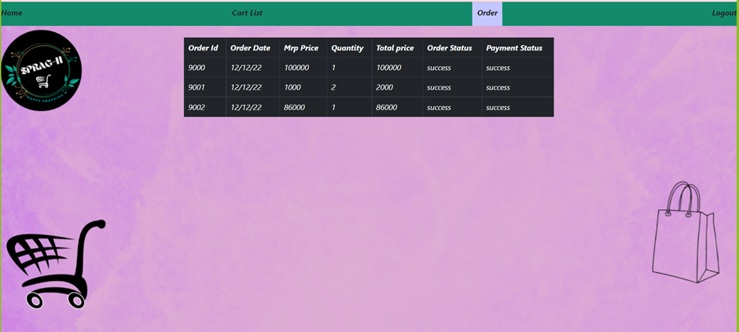
ORDER

Slide 32
CONCLUSION
In this article, we created a simple e-commerce application. We created an API on the backend using Spring Boot and then we consumed it in our frontend application made in Angular. The complete project that we described in this article can be found in the GitHub link.

Slide 33

THANK YOU

